Slide 1

Slide 1
Highcloud Airlines

Slide 2
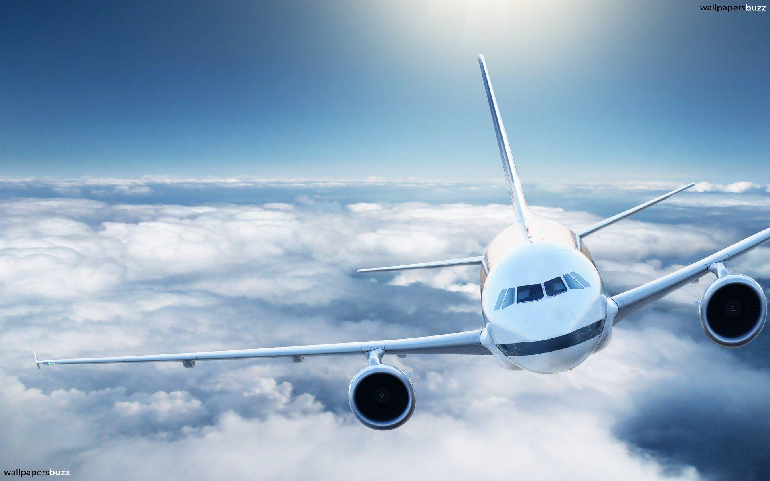
Slide 2
Yearly Analysis
1.Load factor percentages range from 53.54% to 55.41% over the six-year period.
2.Highest load factor: 2013 (55.41%)
3.Lowest load factor: 2008 (53.54%)
4.Overall increasing trend in load factor from 2008 to 2013.
5.Yearly load factor shows slight fluctuations but maintains an upward trajectory.
2

Slide 3
Slide 3
Carrier based on Passenger preference
e
29M
Southwest Airlines Co. emerges as the top carrier based on passengers' preference, with the highest number of passengers transported.
Delta Air Lines Inc. follows closely as the second most preferred carrier.
Other carriers in the top 10 also demonstrate significant passenger preference, contributing to a competitive landscape in the airline industry.
34M
Southwest Airlines Co.
Delta Air Lines Inc.
16M
13M
US Airways Inc.
Continental Air Lines Inc.
3

Slide 4

Suggestions
Route Optimization Strategies: Considering the significance of the Atlanta, GA to Chicago, IL route and its demand factors, prioritize route optimization efforts. This may involve adjusting flight schedules to better align with peak travel times, introducing additional flights during high-demand periods, and leveraging market trends to maximize passenger load factors.
Competitive Analysis: Conduct a comprehensive analysis of the competitive landscape on the Atlanta, GA to Chicago, IL route. Identify key competitors and their strategies, pricing models, and customer offerings. Use this information to differentiate Highcloud Airlines' services, enhance customer value proposition, and gain a competitive edge.
Seasonal Variations and Market Trends: Capitalize on seasonal variations and potential growth opportunities identified in market trends. For example, during peak travel seasons or special events, consider offering promotional fares, increasing flight frequency, or introducing special amenities to attract more passengers and maximize revenue.
Load Factor Optimization: Utilize insights from the % Load Factor on a yearly basis to optimize capacity and improve load factors. Identify factors contributing to fluctuations in load factors and implement strategies to address them. This may include adjusting pricing strategies, enhancing customer experience, or refining route planning to better match supply with demand.

Slide 5

Partnership Opportunities: Explore partnership opportunities with top carriers like Southwest Airlines Co. and Delta Air Lines Inc. to expand route networks, improve connectivity, and enhance passenger convenience. Collaborations such as codeshare agreements or interline partnerships can provide access to additional destinations and attract more passengers.
Customer Engagement and Loyalty: Enhance customer engagement and loyalty programs to retain existing passengers and attract new ones. Offer personalized experiences, exclusive benefits, and rewards for frequent flyers to strengthen brand loyalty and increase passenger preference for Highcloud Airlines.
Continuous Improvement: Emphasize a culture of continuous improvement across all aspects of operations, including safety, reliability, customer service, and innovation. Regularly evaluate performance metrics and customer feedback to identify areas for improvement and implement necessary changes to maintain a competitive position in the airline industry.
Implementing these suggestions can help Highcloud Airlines optimize its operations, improve passenger satisfaction, and strengthen its competitive position in the market.

Slide 6
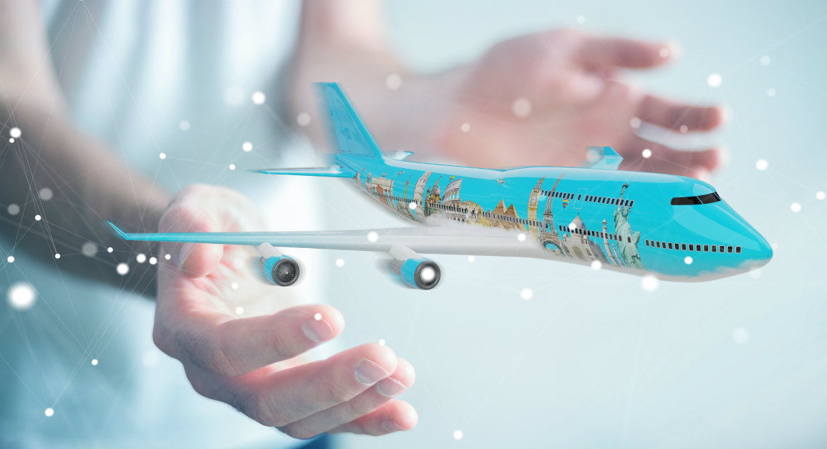
Slide 10
Feedback
Customer Service: Ensure that customer service representatives are friendly, knowledgeable, and responsive. Promptly address customer queries and issues to enhance customer satisfaction.
Flight Experience: Improve the overall flight experience by offering comfortable seating, clean cabins, and quality in-flight entertainment options. Consider offering complimentary amenities to enhance the overall experience.
Pricing and Value: Review pricing strategies to ensure competitiveness in the market while offering value to customers. Consider offering promotions or discounts to attract more customers.
On-Time Performance: Strive to improve on-time performance by optimizing flight schedules and minimizing delays. Keep customers informed of any changes to their flight schedule.
Safety and Security: Prioritize safety and security measures to ensure the well-being of passengers and staff. Regularly review and update safety protocols to meet industry standards.
Feedback and Communication: Encourage customers to provide feedback and suggestions for improvement. Actively communicate with customers to keep them informed of any changes or developments.
Employee Training: Provide regular training and development opportunities for employees to enhance their skills and knowledge. Ensure that employees are well-equipped to provide exceptional service to customers.
Overall, focusing on these areas can help Highcloud Airlines enhance its services and improve customer satisfaction.
Your logo
10

Slide 7
Slide 11
THANK YOU

